Slide 1

Interactive Information Report

Slide 2
Contents Page
Please click on your preferred option and remember to use the back button.
Co-op Academy Woodslee Information Report
Frequently Asked Questions

Slide 3
Co-op Academy Woodslee Information Report
Local Authority Offer
Return to Contents
What kind of special educational needs and disabilities are catered for at Co-op Academy Woodslee?
How does Co-op Academy Woodslee know that a child / young person needs extra help and what do I do if I think my child / young person has special educational needs?
How does Co-op Academy Woodslee assess and identify the needs of their children / young people?
How will teaching and the curriculum be adapted to meet the needs of my child / young person?
How do we know that the support provided to children / young people is effective?
How do you and I know that your child / young person is making progress and meeting their targets?
How do we involve and support parents of children / young people with SEND?
How do we involve children / young people with SEND in shaping their education and future?
How will my child be included in activities outside the classroom including trips?
How will Co-op Academy Woodslee support my child / young person’s social and emotional wellbeing?
How is the school environment made accessible?
Equipment and facilities to support children with SEND at Co-op Academy Woodslee
What expertise for supporting children / young people with SEND do our staff have and what training have they received in the last 3 years?
What other experts do we work with?
How our Governing body involve health, social care agencies, LA support services and other bodies in meeting the needs of children with SEND.
The contact details of support services for parents of children with SEND, including those for arrangements made in accordance with section 32.

Slide 4
Co-op Academy Woodslee Information Report
Local Authority Offer
Return to Contents
What to do as a parent if you have a complaint about SEND at our school
How do we ensure that all members of our academy community are valued and differences respected?
How will Co-op Academy Woodslee prepare and support my child / young person moving to or from our academy.
Hhow do we prepare them to join the next stage of education and life?
The name and contact details of the SEND co-ordinator and SEND Governor.

Slide 5
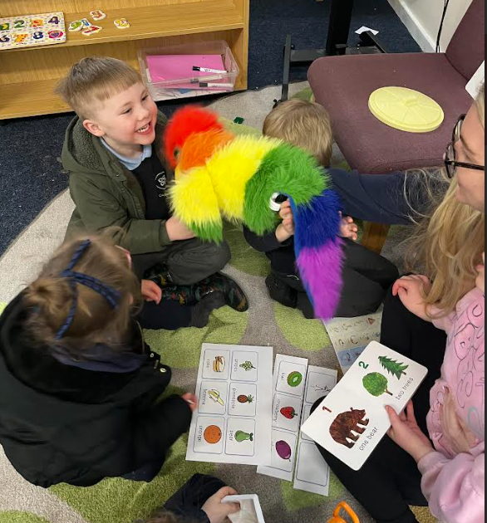
Co-op Connect Resource Provision
At Coop Academy Woodslee we have three established resource provisions. Our Co-op Connect provisions cater for a range of complex needs The Co-op Connect provision caters for children with a variety of complex needs.
These include:
Language and learning difficulties
Autism
Attention deficit hyperactivity disorder (ADHD)
Social, emotional and mental health needs (SEMH)
Our Connect Curriculum:
Meets the needs of children with a wide range of aptitudes and abilities,
Is broad and balanced,
Includes an emphasis on life skills and basic skills,
Includes methods and approaches that meet the needs of each individual child,
Supports the outcomes described in each child’s Education, Health and Care Plan (EHCP).
Our Connect curriculum model aims to:
Maximise each pupil’s engagement,
Support outstanding progress across all areas of learning,
Provide motivating and relevant learning opportunities and developmental activities,
Adopt a personalised approach that allows staff to plan in response to a pupil’s individual needs and interests and take into account their barriers to learning,
Use a combination of Life Skills and Basic Skills to ensure that pupils are well prepared for the next phase of their education,
Lay the foundations for pupils to have a meaningful and independent adult life and are well-placed to make a positive contribution to life beyond school,
Base learning opportunities on real-life experiences in engaging, cross-curricular, innovative, and stimulating and inspiring ways,
Promote pupils to engage, participate and try hard,
Provide children with the foundations for learning so that they can achieve and progress at their own pace,
Develop essential Life Skills throughout each day and learn Basic Skills, based on the specific areas of learning described in Early Years, Foundation Stage (EYFS), in every session.

Slide 6
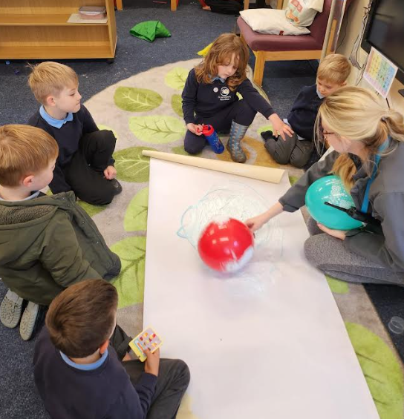
What kind of special educational needs and disabilities are catered for at Co-op Academy Woodslee?
Back
At Co-op Academy Woodslee, we aim to offer excellence and choice to all our children, whatever their ability or needs. We have high expectations of all our children. We aim to achieve this through the removal of barriers to learning and participation. We want all our children to feel that they are a valued part of our school community.
We recognise that children learn at different ways and that there are many factors affecting achievement.
We know that children may have difficulties over a short or long period of time, in one or more of these areas:
Cognition and Learning
Sensory and Physical needs
Social, Emotional and Mental Health
Communication and Interaction needs.

Slide 7
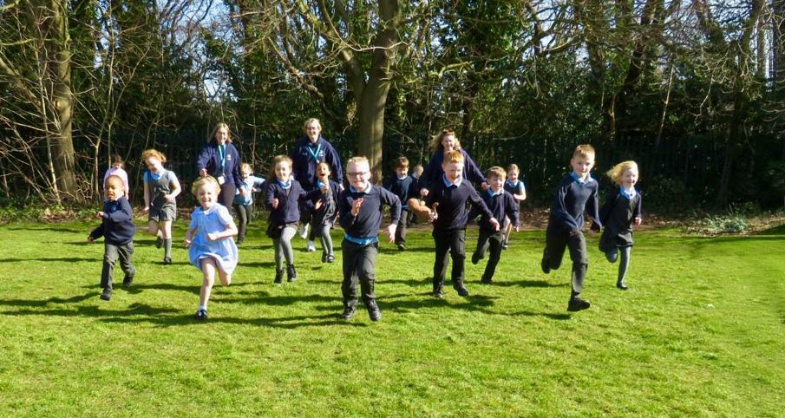
How does Co-op Academy Woodslee know that a child / young person needs extra help and what do I do if I think my child / young person has special educational needs?
How does Co-op Academy Woodslee assess and identify the needs of their children / young people?
Back
Children may be identified and assessed as having SEND if their development is:
Very different from that of their peers starting from the same baseline
Significantly slower than that they previously attained
A widening of the gap between the child and their peers
Support is required to prevent a progress or developmental gap growing wider.
Advice on how to identify, assess and support children with SEND comes from internal and external sources such as parents/carers, class teacher, school leadership team, previous educational setting, school nurse, family support workers. Provision is planned and delivered for all children by the class teacher - who may have some additional support such as a teaching strategy or a teaching assistant. We believe a child’s needs should be identified and met as early as possible.
Assessment is completed in many forms including data tracking, reviews, observations and parent meetings. Children’s progress is tracked by the class teacher and evaluated by the school’s leadership team. The effectiveness of SEND provision is regularly monitored by the Senior Leadership Team and governors and is led by Miss Sarah-Jo Ball, the SENDCo.
Our SEND One Page Policy is shared on the school website alongside all other policies.

Slide 8
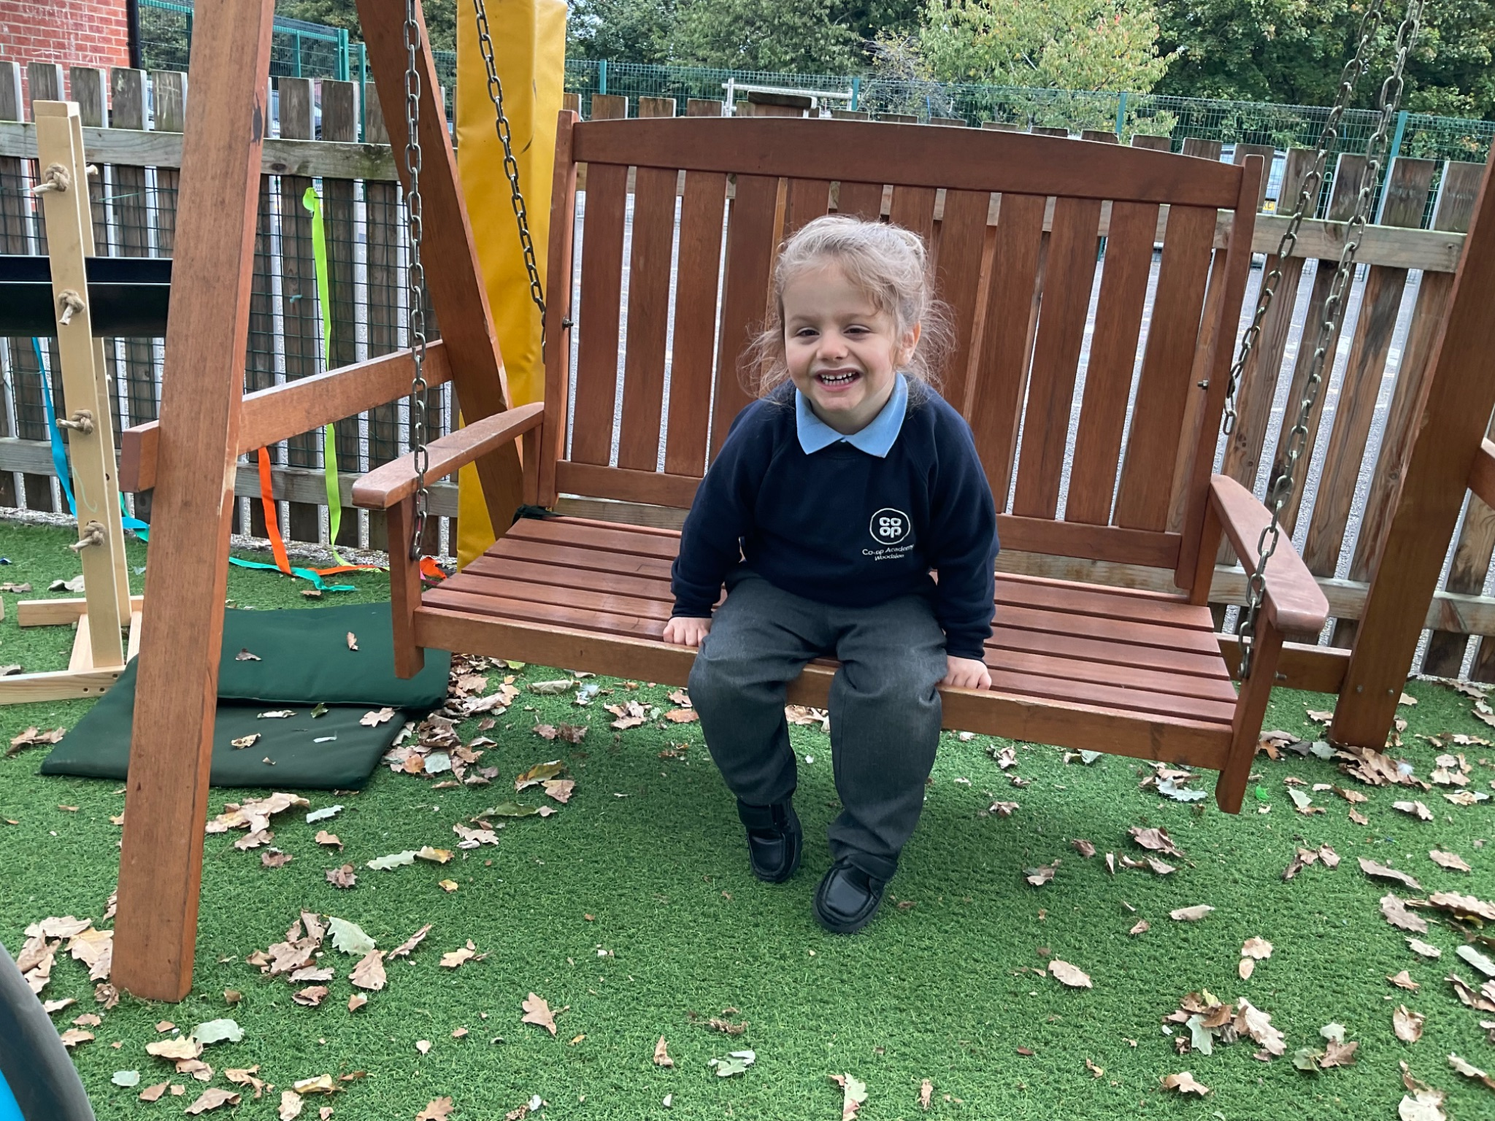
How will teaching and the curriculum be adapted to meet the needs of my child / young person? How do we know that the support provided to children / young people is effective?
Back
Children’s needs are assessed and class teachers plan lessons with all groups of children in mind and will ensure that the curriculum is adapted to suit the needs of individuals. Your child may have additional adults working with him / her both inside and outside of the classroom to help him / her achieve progress.
The class teacher will adapt the curriculum to help all children gain access to the learning.
Ways in which this may be done are:
Differentiated / adapted tasks according to ability
Additional adult support
Simple instructions
Task cards
Use of kinaesthetic, visual or auditory resources
Outside agency advice and specific programmes depending on the needs of the individual.
Classrooms can be adapted, for example, we may use a workstation or a quiet area and areas outside of the classroom are used for specific programmes.
There is a disabled toilet with a changing facility.
Class teachers monitor the progress of all of the children in their class and regular assessments are in place so that we can all be sure that the support provided is effective.

Slide 9
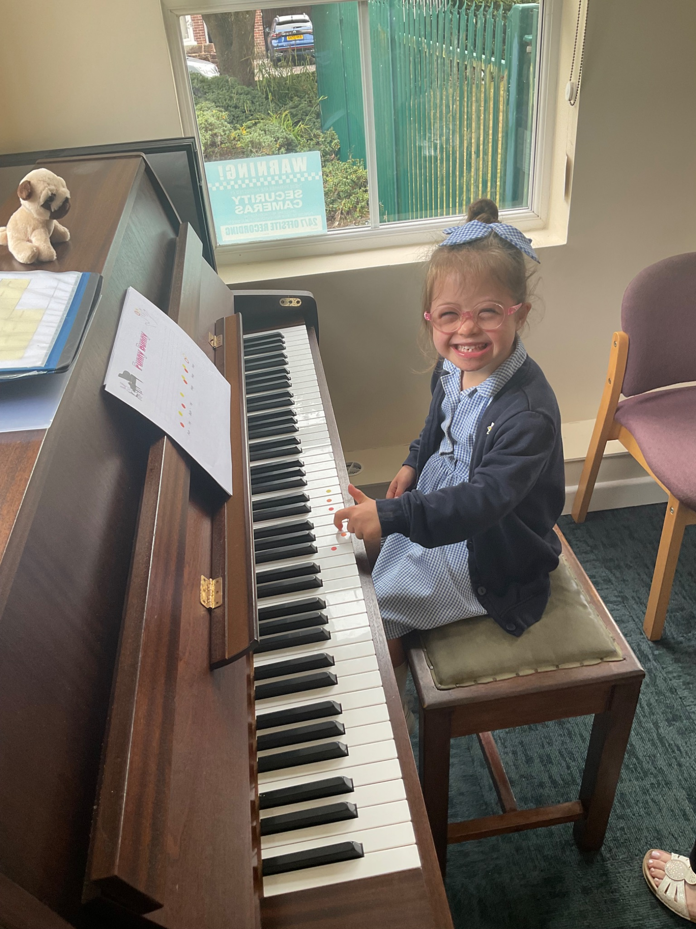
How do you and I know that your child / young person is making progress and meeting their targets?
Back
Every child is monitored that they have understood the learning throughout each lesson. We have ‘Do Now’ quizzes at the start of each lesson to check children have understood and remembered the learning in the previous lessons.
Every child will undertake termly assessments to check that they are making progress.
Children with SEND may have additional assessments:
Each child on the SEND Register will have a Pupil Passport with individualised targets on. This is assessed termly and will evidence progress.
WRAT 5 assessments provide standardised scores in reading, spelling, maths and comprehension. These assessments help us to identify any areas your child may be finding particularly difficult.
Strengths and Difficulties Questionnaires (SDQs) – these assessments provide information on behaviours related to emotions, conduct, hyperactivity, and peer relationships.

Slide 10
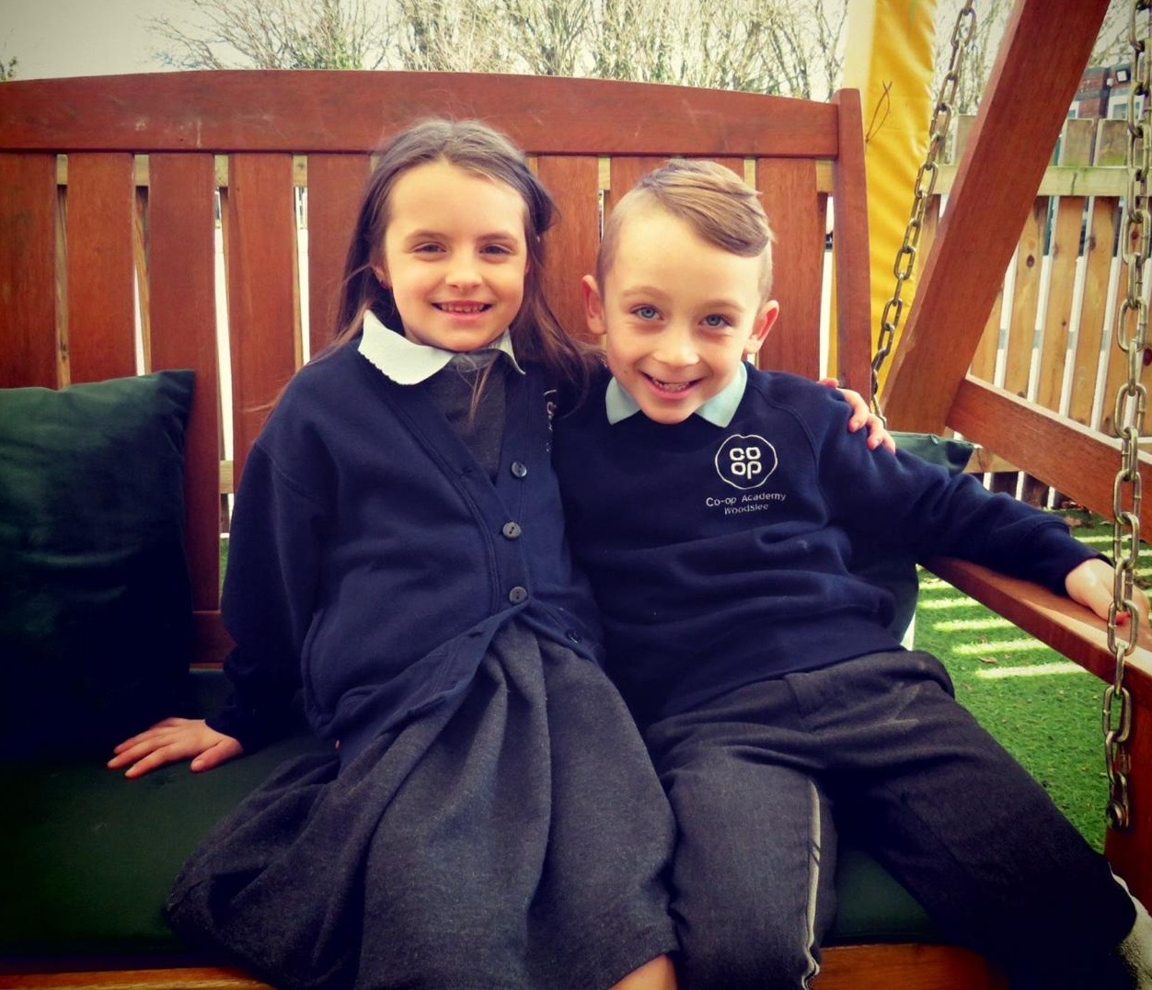

How do we involve and support parents of children /
young people with SEND?
Back
Parents/carers are always welcome to come into school and make an appointment to see a member of staff to discuss their child and an appointment should be made at the school office.
The senior leadership team are available on the playground in the morning to answer any parent/carer concerns.
We will hold a minimum of 3 termly review meetings where you will be involved in discussions about your child’s progress and the setting of new targets. You will also be involved in the annual review meeting if you have a child with an EHC plan.
A child’s views will also be considered at the annual review process and when the class teacher is completing their Pupil Passport. Parents will also share their knowledge about their child through completing the transition document. All people present are invited to help develop the support for the child and the child themselves will have the chance to give their views and aspirations.
Parents/carers who have EAL (English as an Additional Language) may wish to have a translator. Parents/carers may also bring to the meeting a parental
supporter.

Slide 11


How do we involve children / young people with SEND in shaping their education and future?
How will my child be included in activities outside the classroom including trips?
Back
Inclusion is at the heart of everything that Co-op Academy Woodslee does.
Staff will discuss a child’s progress with them and the child’s views will be taken into consideration when discussing progress and target setting.
Children with SEND are encouraged to comment on their Pupil Passports, they always help to create their own and attend part of their annual PFA or EHCP review meetings.
All staff actively listen to children and endeavour to respond appropriately to their needs – vocalised or otherwise indicated.
All children are included on trips or activities outside of the classroom and any adaptations will be made that may be needed.

Slide 12
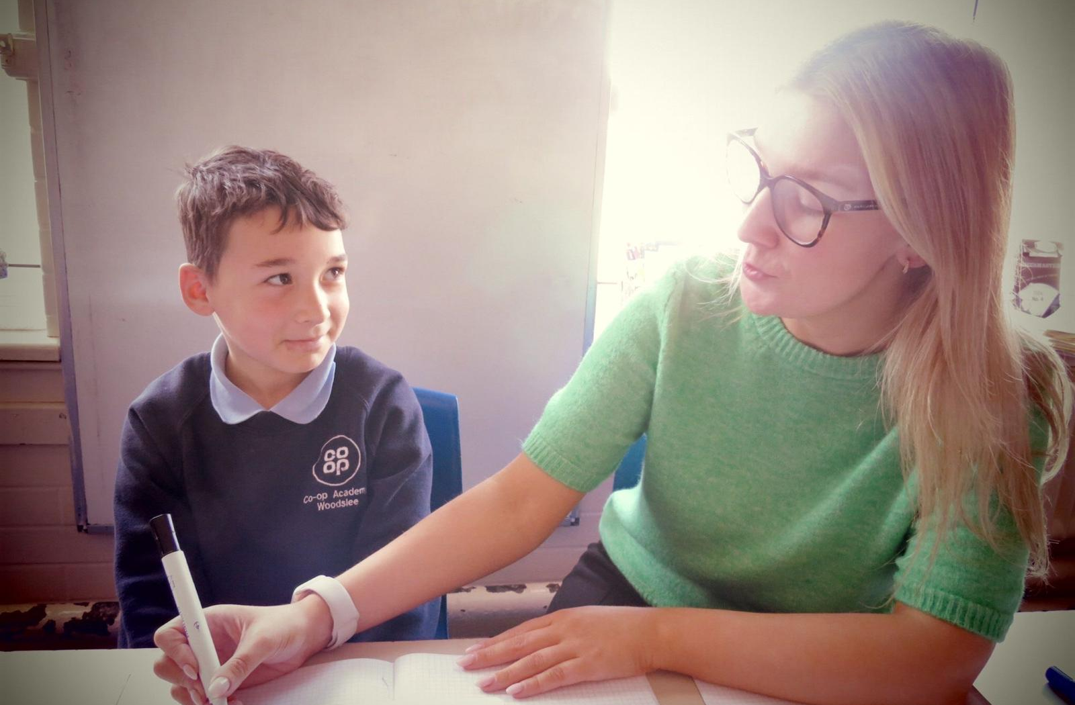
How will Co-op Academy Woodslee support my child / young person’s social and emotional wellbeing?
Back
Strengths and Difficulties Questionnaires (SDQs) are used to highlight and social and emotional difficulties.
We can provide a range of interventions in school to address any areas of difficulties.
We access support from the NHS Mental Health Support Team – they can work with either parents or children.
We also access support from Crea8ing Communities – they provide a range of mental health, emotional and social support and interventions.
We teach children to be self-regulated learners – the focus is on developing resilience, teaching children how they learn best and how they can set themselves goals.

Slide 13
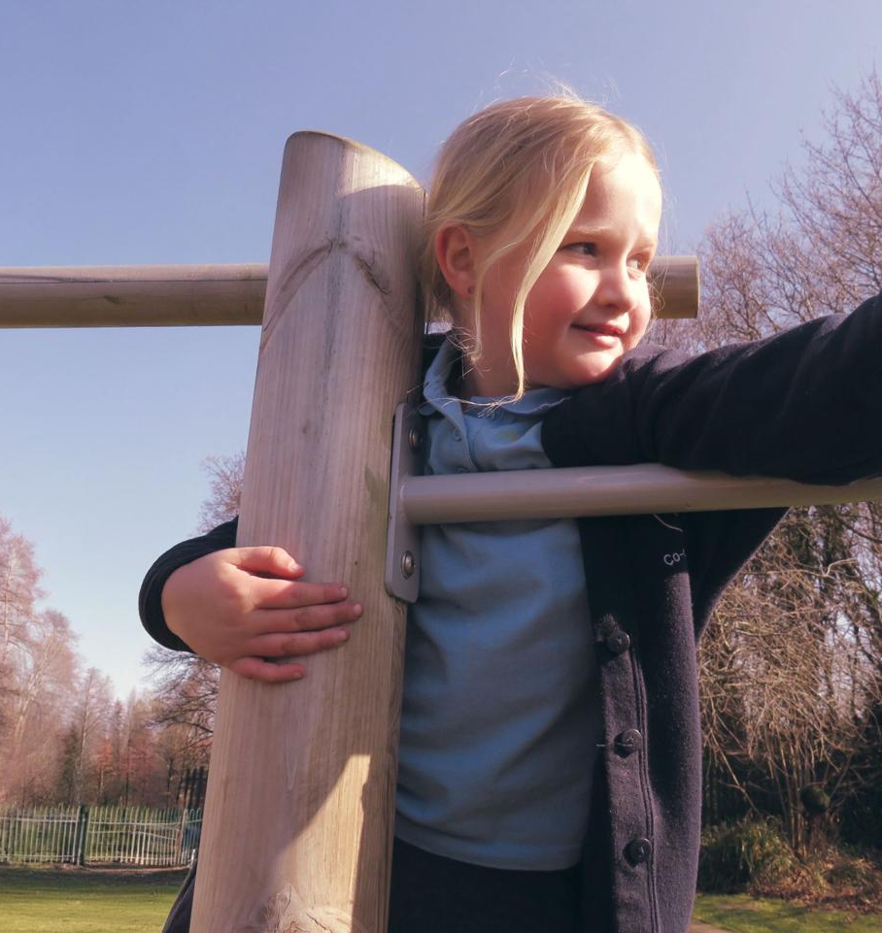
How is the school environment made accessible?
Back
Children will have their support documented through the use of either a Pupil Passport, costed provision map, an Education Health and Care Plan or an Individual Health Care Plan.
Pupil Passports are usually written by the class teacher and detail the support the child will receive within school.
Most provision, equipment and facilities on these plans will be devised by the class teacher within the classroom. This will capture the child and parent/carer voice.
For a few children this provision might need to be supported by the SENDCo, who may need to involve other agencies in developing class teaching techniques etc.
These recommendations will be shared by the SENDCo with the class teacher, parents / carers and meetings may be arranged up to three times a year to discuss progress.
Co-op Academy Woodslee has an Accessibility Policy to ensure relevant adaptations are made.

Slide 14

What expertise for supporting children / young people with SEND do our staff have and what training have they received in the last 3 years? What other experts do we work with?
Back
All of our staff have been trained to deliver High Quality Teaching. We use external agencies to deal with a particular difficulty a child may have and these can include:
Speech and Language Therapists
Autism Team
School Nurse (confidential appointments and support are available from the school nurse. Parents can request an appointment to meet with the school nurse.)
Educational Psychologists – We access the Educational Psychology services. The psychologist will generally meet with the parents for an initial consultation. He/ she will offer advice for the academy and parents/ carers on how to best support the child in order to take their learning forward.
Occupational Therapists
Staff are kept up to date with training through staff meetings and training delivered by either external agencies or our SENDCo. We use a Trauma Informed approach through staff being trained and advised by our SENDCo. Our staff have also had training on providing Dyslexia friendly classrooms and different strategies that can be used for children with reading and spelling difficulties.
This year, we are focussing on staff being trained on a Speech and Language programme called Colourful Semantics to help children develop their speaking and writing skills.

Slide 15
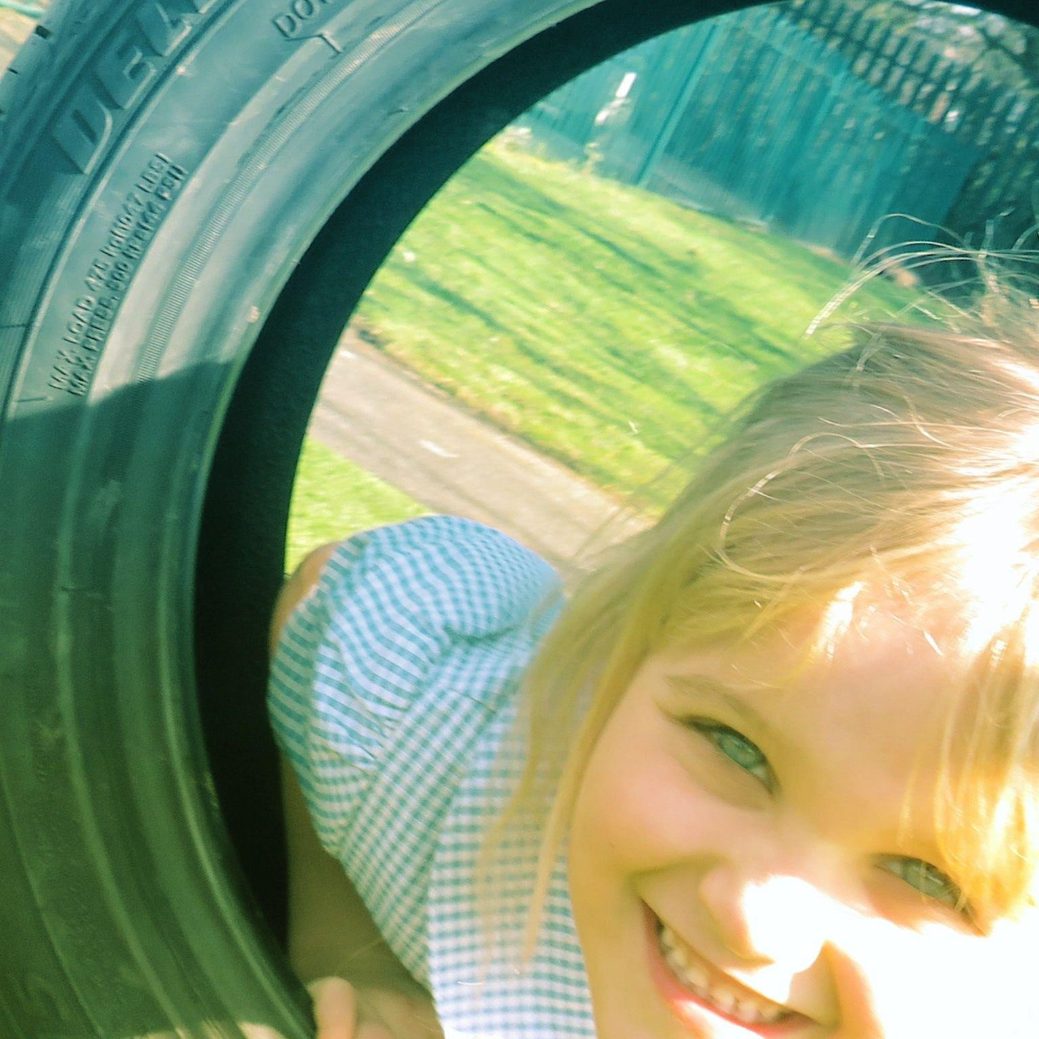
What to do as a parent if you have a complaint about SEND
at our school.
Back
Initial complaints should be directly raised with the class teacher as most concerns can be quickly ironed out at this stage.
All complaints regarding SEND provision follow the academy’s complaints policy.
If the complaint remains unresolved, the complaint can be forwarded to our Head of School. The complaint may be directed by the Head of School to the Chair of Governors and/or the Governor for SEND.
Parents will also be advised of their right to refer matters of dispute to the Disagreement Resolution Service. Should action need to be taken the complaints procedure will be followed.
Wirral’s SEND parent partnership is a useful resource and can be accessed on the link below:
http://www.wired.me.uk/Parent-Partnership.asp

Slide 16
The name and contact details of the SEND Co-ordinator:
Back
Our SEND Team consists of:
SENDCo - Miss Ball
EHCP Liaison Officer - Janine Barton
SEND Governor - Cheryl Walker
Executive Headteacher - Katy Bergman
They can be contacted by phone on 0151 334 1406
or email: woodslee-office@coopacademies.co.uk

Slide 17
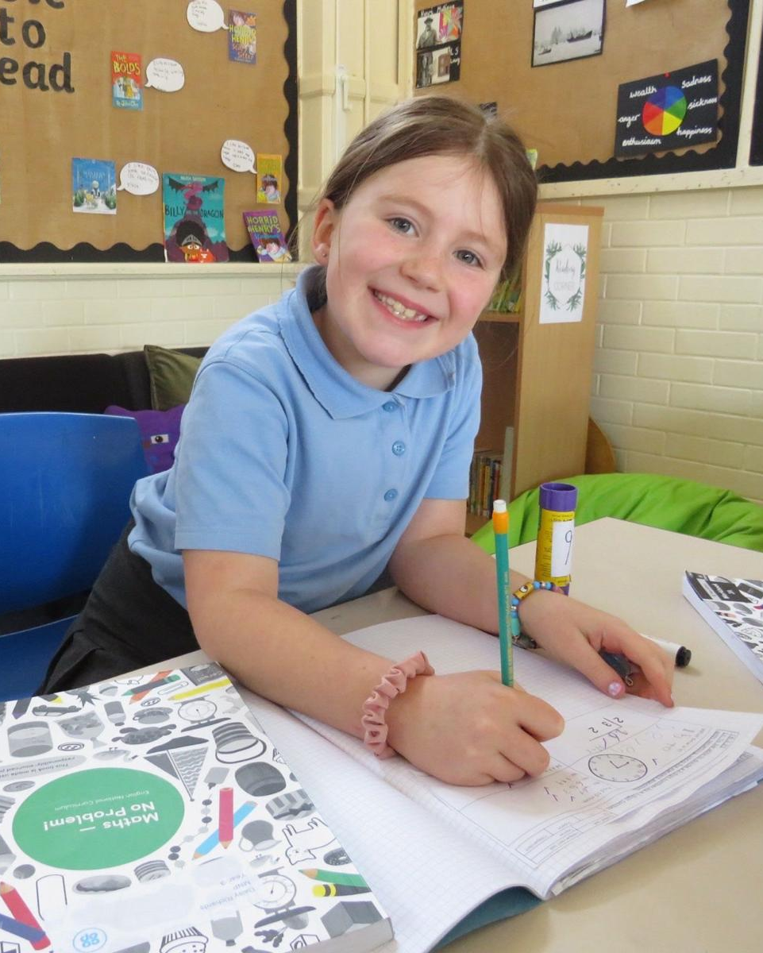
Equipment and facilities to support children with SEND at
Co-op Academy Woodslee
Back
For children with a medical condition an Individual Health Care Plan (IHCP) may need to be written with parents/carers and the SENDCo, to guide staff about how to manage these needs. Children with more complex medical conditions may need to have a plan written that involves medics who should also attend the meeting.
Necessary additional medical advice to support the medical needs would be detailed at these meetings and provided by the medical team. Woodslee also has a small designated medical room that children may use, if necessary.
If children’s needs go beyond our school’s expertise, further advice maybe sought from the local authority. Further support for children may be provided by the LA through a Pupil Funding Agreement (PFA) or for those with education, health and care issues an Education, Health Care Plan (EHCP).
If a child obtains a PFA / EHCP the Local Authority will look at Woodslee’s facilities and decide on the most appropriate action to support the child – this maybe at Co-op Academy Woodslee or at a specialised base (within school potentially) or alternate provision. For both a PFA and an EHCP children, parents/carers, schools and other agencies need to work together to achieve a good outcome.
Children may also have additional input/support through the use of pupil premium money and personal budgets in the future.

Slide 18
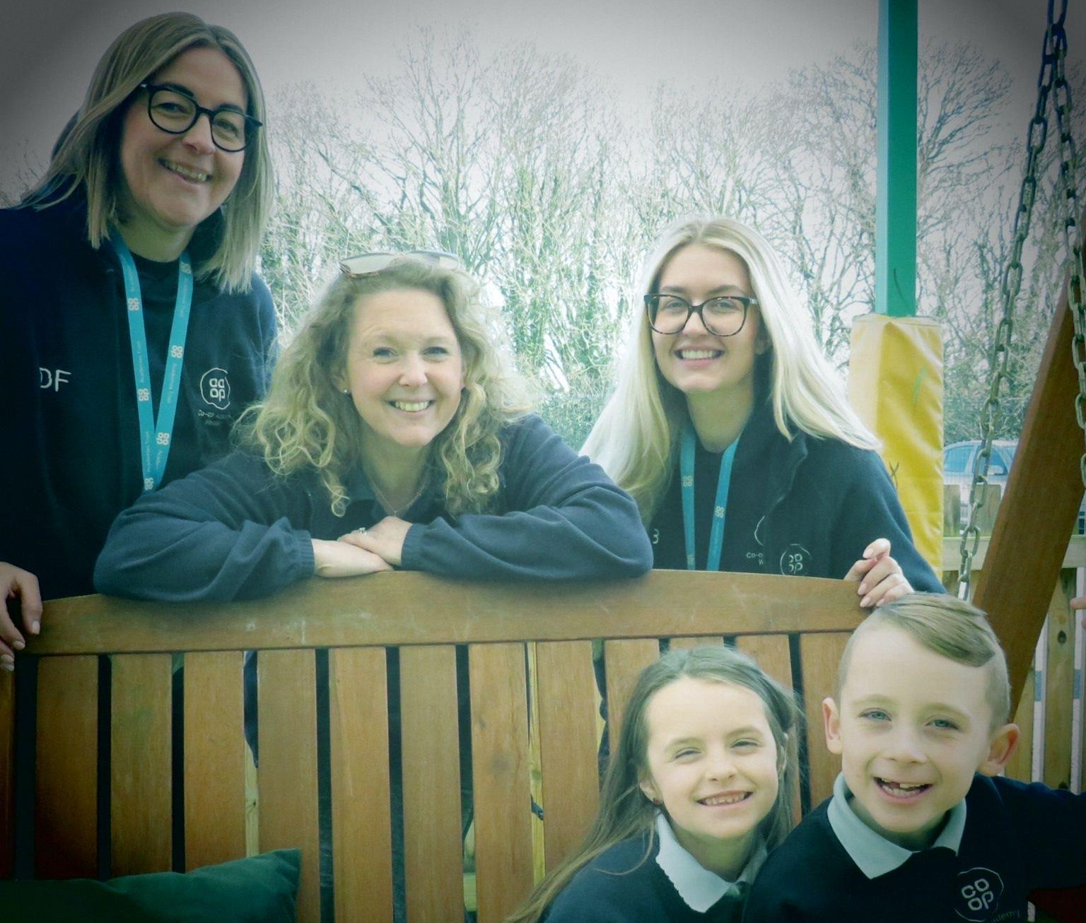

How our Governing body involve health, social care agencies, LA support services and other bodies in meeting the needs of children with SEND.
Back
We work closely with a range of external agencies, please see the list in Slide 13.
We signpost families to additional services to help gain the support they may need.
The Local Authority’s Local Offer can be accessed via our website and this service signposts parents, carers and school staff to a wide variety of external support and services.
Our families also have access to our Designated Safeguarding Lead, Ms Claire Rutherford
They will provide support where needed and signpost you to agencies that can help – a problem shared is a problem halved.

Slide 19


The contact details of support services for parents of children with SEND, including those for arrangements made in accordance with section 32.
Back
These are available through the local authority’s local offer which is published at: SENDLO Wirral. Wirral's Local Offer of SEND Services

Slide 20

How will Co-op Academy Woodslee prepare and support my child / young person moving to or from our academy and how do we prepare them to join the next stage of education and life?
Back
At Woodslee, we will try to make any transition as smooth as possible to avoid any additional anxiety for your child.
Parents/carers and a child’s previous setting should inform staff if a child has known SEND.
At foundation stage, Family Partnership Worker / FS teachers will arrange to visit the preschool/ home. Children will also be invited for a short session in school if appropriate. For children in key stage 1 and key stage 2, visits before the child starts at our school are given and an appointment with the class teacher / SENDCo can be made at any time either in person or by phone to discuss your child.
Our Inclusion Manager (Ms Kilby) will conduct home visits for families and encourages visits to the school to improve familiarity with the setting.
Between each class/phase at Woodslee all children are given transition time. Staff will meet to discuss their new children and any additional needs they may have.
All official paperwork and records are kept and passed onto the next teacher or setting. Parents are informed of their child’s new class teacher via their child’s end of year report.
For secondary school transfers, year heads, pastoral teams and SENDCos, from the receiving school, talk to our staff. Additional meetings are held, when felt necessary, which parents and children are both invited to. For some children, the secondary schools may provide enhanced transition support which may include additional visits and staff meeting the child individually at Woodslee in preparation for secondary school, children will engage in learning opportunities relating to transition and the changes ahead.

Slide 21

How do we ensure that all members of our academy community are valued and differences respected?
Back
To ensure that all members of an academy community are valued and differences are respected:
Facilitate open, honest discussions about differences and promote understanding and respect for people from all abilities and backgrounds. We follow the No Outsiders Curriculum and celebrate differences.
Build a culture of community and belonging for pupils, removing barriers to learning and participation, and promoting high standards for all children. Inclusion is at the heart of all we do, the inclusion of our whole school community.
Actively promote equity of opportunity, ensure that members of the academy community know their rights, and reject prejudice or discrimination.
Our PSHE curriculum will address these important issues to help our children grow into responsible members of their community.

Slide 22
Thank you for looking at our school information report.
This next section, frequently asked questions, may help to answer any queries you might have.
If you need further information please contact our school by either coming in, phoning 0151 334 1406 or emailing: woodslee@coopacademies.co.uk

Slide 23
Frequently asked questions
FREQUENTLY ASKED QUESTIONS (Click on the question you need the answer to)
1. How will you know if my child needs extra help? | 2. What should I do if I think my child may have special educational needs? | 3. How will staff support my child?
4. How will the curriculum be matched to my child’s/young person’s needs? | 5. How will I know how my child is doing and how will you help me to support my child’s/young person’s learning? | 6. What support will there be for my child’s overall well-being?
7. What specialist services and expertise are available or accessed by you? | 8. What training are the staff supporting my child with SEND had or are having? | 9. How will my child be included in activities outside the classroom including school trips?
10. How accessible is your school? | 11. How will you prepare and support my child to join your setting or school and transfer to a new setting or school for the next stage of education and life? | 12. How are your resources allocated and matched to my child’s needs?
13. How is the decision made about what type and how much support my child will receive? | 14. Who can I contact for further information? 16. How will information about the child be circulated to all members of staff and who will be responsible for that? | 15. Can staff get extra help from experts outside if they need to? (eg advice and training on medical conditions)
Return to Contents
Click on the question you need the answer to
1. How will you know if my child needs extra help?
2. What should I do if I think my child may have special educational needs?
3. How will staff support my child?
4. How will the curriculum be matched to my child’s/young person’s needs?
5. How will I know how my child is doing and how will you help me to support my child’s/young person’s learning?
6. What support will there be for my child’s overall well-being?
7. What specialist services and expertise are available or accessed by you?
8. What training are the staff supporting my child with SEND had or are having?
9. How will my child be included in activities outside the classroom including school trips?
10. How accessible is your school?
11. How will you prepare and support my child to join your setting or school and transfer to a new setting or school
for the next stage of education and life?
12. How are your resources allocated and matched to my child’s needs?
13. How is the decision made about what type and how much support my child will receive?
14. Who can I contact for further information?
15. Can staff get extra help from experts outside if they need to? (eg advice and training on medical conditions)
16. How will information about the child be circulated to all members of staff and who will be responsible for that?

Slide 24
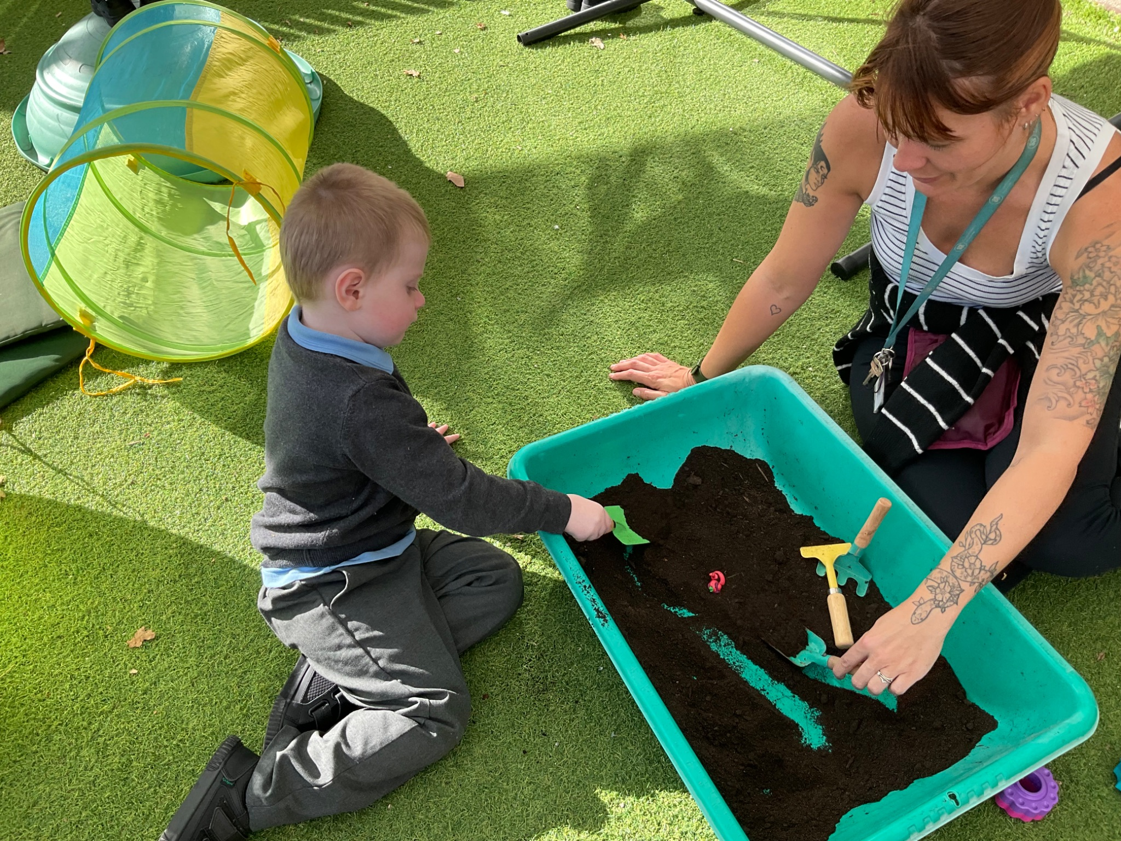
1. How will you know if my child need extra help?
FAQ’s
At school, we are constantly assessing your child’s progress both in line with their previous attainment and development and that of their peers, both academic and contextual progress is monitored.
If your child appears to be developing at a different rate to expected norms, the class teacher or SENDCo will approach you and discuss any concerns with you.
Concerns may be raised if:
There is little or no progress academically;
Social emotional difficulties are becoming challenging;
Sensory/ physical difficulties become evident;
A specific difficulty is evident in English or maths skills;
Social communication or interaction problems increase despite intervention;
Speech and communication skills do not develop appropriately.

Slide 25
2. What should I do if I think my child may have special educational needs?
3. How will staff support my child?
FAQ’s
Come into school and talk to your child’s class teacher as they will be the person who knows your child best.
You may also want to speak to the school SENDCo, Miss Sarah-Jo Ball.
We aim to meet the needs of all our children within the classroom through high quality teaching. Some children may require further support within the classroom or school. This support could be delivered by; class teacher, another teacher, teaching assistant or additional staff who are employed by the school through the local authority via the Executive SENDCo.
The resources, staff involved, staff roles and frequency of support offered to your child would be dependent on their needs and this would be clearly shown on your son/daughter’s Pupil Passport. The Pupil Passport would be explained to you by the class teacher at each termly review.
The school Executive SENDCo, leadership team and governors are involved in the monitoring of provision and its effectiveness.

Slide 26
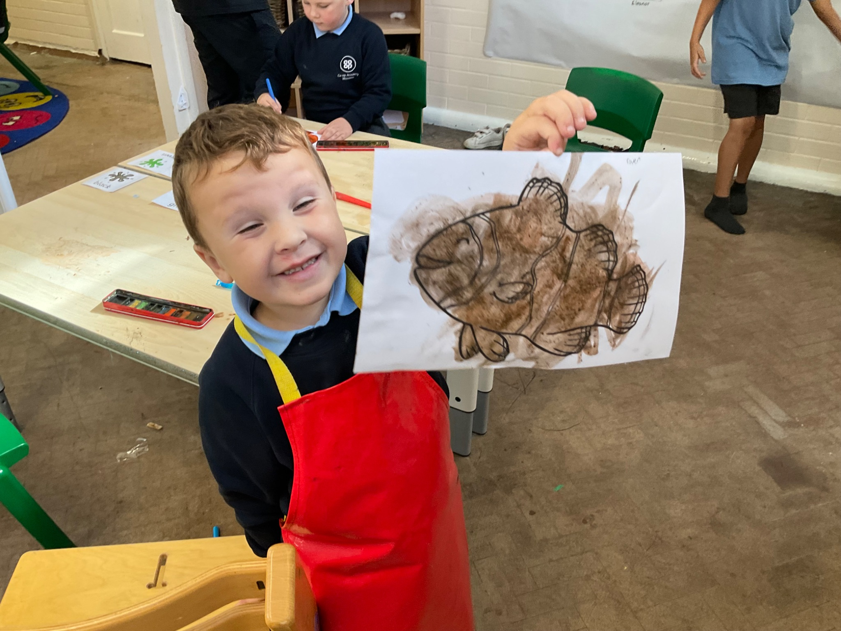
4. How will the curriculum be matched to my child’s / young person’s needs?
FAQ’s
All our children have access to a broad and balanced curriculum. Each teacher has high expectations for their children based on prior assessment and will adapt their teaching to allow for individual progress.
Potential areas of difficulty for a child will be considered during planning, to allow for each child to be included in the class learning and achieve their own personal goal.
This personalised approach allows individual children to flourish. Staff use a multi-sensory approach to their teaching to respond to their children’s diverse needs.

Slide 27
5. How will I know how my child is doing and how will you help me to support my child’s / young person’s learning?
FAQ’s
Opportunities to discuss your child’s progress are offered 3 times a year – twice at parent evenings (in the autumn and spring term) and once at the end of the summer term in a written report and opportunity to discuss/ respond.
Teachers are often available at the end of the day to have a quick discussion with parents/carers to discuss a child’s progress if required. For a matter that may take longer, parents/carers are asked to make an arrangement to meet staff through the reception staff at the office. As a school we would rather see/speak to you as soon as you have a concern, rather than letting you worry about an issue. A member of SLT will be available on the playground every morning.
Class teachers assess children daily and how they are progressing with their work. Every half term class teachers complete assessment tasks on all children to monitor their progress. These assessments are used to inform all teaching staff of children’s progress and as a baseline for future planning.
When a child starts at school we will endeavour to meet parents/carers to discuss their child’s needs. If a child arrives at school with SEND, the SENDCo and teachers should be informed of this by the parents/carers.
At foundation stage, staff arrange meetings for parents, a home visit if requested and a staged school induction. For children in key stage 1 and key stage 2, visits before the child starts at our school are given and an appointment with the class teacher can be made at any time, either in person or by phone, to discuss your child.
CONTINUED…

Slide 28
5. How will I know how my child is doing and how will you help me to support my child’s / young person’s learning? (Continued)
FAQ’s
For a child with SEND, a Pupil Passport is produced by the class teacher and this will give details of what additional support a child will get from school. At parents evening, staff will discuss this support with you and offer suggestions for how you can help at home.
Staff will also listen to your suggestions and discuss with you how to support your child with their development at home. Extra appointments to meet staff can be made at the office between these meetings or at the end of school.
If your child has complex needs, a meeting may need to be arranged between yourself and all the other professionals involved with your child’s development, to ensure your child achieves their potential in all areas of development.
At Co-op Academy Woodslee, we run some parent workshops and other information sessions. We also can arrange drop-in sessions with our school nurse, SENAAT, SENDCo and speech and language therapist.
We also hold regular SEND drop-in sessions for parents with our very own SEND specialist and Executive Headteacher, Ms Bergman.

Slide 29
6. What support will there be for my son’s or daughter’s overall well-being?
7. What specialist services and expertise are available or accessed by you?
FAQ’s
Medical support and advice for children is provided by our school nurse. Please speak to the school SEND team if you need to contact the school nurse. Alternatively, there is a school nurse drop-in clinic at St. Catherine’s Hospital.
Pastoral support is primarily provided by your child’s class teacher. Children are encouraged to speak to their class teacher first if they have any worries or issues in school. However, all school staff are trained to listen to our children and children can speak to any member of staff if they need support. We are so lucky to have Ms Kilby who is also available to discuss any worries or concerns that your child may be having. We have a pastoral team who meet regularly to discuss any concerns and to put into place support for children, this is closely monitored and reviewed.
Attendance and punctuality is monitored by our office staff. We aim to follow up any unexplained absences by a telephone call to the parent/carer. When necessary, the social services team may need to be involved.
As a school, we seek and follow the advice of the local authority’s educational psychologist, social and communication teachers, school nurse, family support workers, special educational needs advisory and assessment team, speech and language therapists and hearing and vision support services.
This advice is then used to support the identification, assessment and development of the provision for children with SEND, whether or not they have an Education, Health and Care Plan.

Slide 30
8. What training are the staff offered?
9. How will my child be included in activities outside the classroom including school trips?
FAQ’s
Teachers and teaching assistants will receive training in mandatory safeguarding, first aid, manual handling and fire training. Different members of staff have received training related to SEND including sessions on: Autism; behaviour management; social communication difficulties; speech and language; dyslexia, social emotional mental health; paediatric first aid; intimate care and toileting; the use of a defibrillator; trauma and attachment difficulties; sensory circuits; working memory and ADHD foundation training.
If a child starting at school has an area of SEND that we have not received additional training on in the past, we will look to train our staff so that they are able to support your child. Inclusion and SEND are at the heart of what we do at Co-op Academy Woodslee and staff training is a priority. Staff meetings are regularly related to SEND needs and updates and INSET days, as well as Twilight sessions are planned and led by our SENDCo, Miss Sarah-Jo Ball.
Activities within the normal school curriculum are planned so that all children will be included in them. The outcomes to planned learning activities for children maybe very different, depending on the individual child’s abilities. Parents will be informed of any forthcoming trips in advance. Staff will contact parents if they have any concerns about a child’s involvement in a trip or activity and their suggestions for their child’s inclusion will be sought.
If parents/carers have any concerns about a school trip or an activity within the school day, they should speak to the class teacher or SENDCo. Parents are occasionally asked to volunteer to come on school trips or additional teaching assistants may be deployed to aid all children’s inclusion.

Slide 31
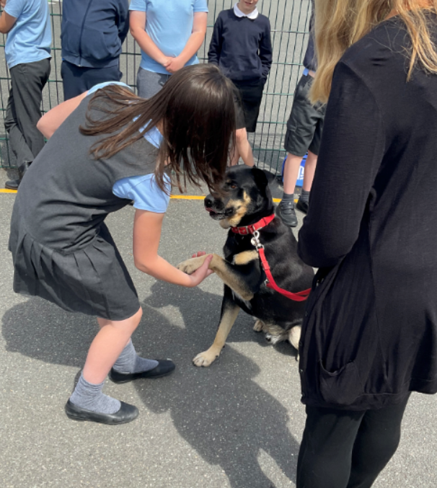
10. How accessible is your school?
FAQ’s
Co-op Academy Woodslee is wheelchair accessible.
We have carpets within all our classrooms and low ceilings to help acoustics. Each classroom has large windows and interactive boards where background colour and brightness, text size and style may be altered to suit children’s needs.
Foundation stage have their own toilets within their classroom settings. In key stage 1 and 2, toilets are situated in close proximity with access to a disability friendly toilet at the end of each corridor.
There are separate spaces that can be used as medical rooms and private spaces when required for the administration of medication or intimate care support.
For parents/carers whose first language is not English, we use the support of the MEAS team. F
or arranged meetings we will employ the services of a translator when possible and parents can bring with them a friend or support who is more fluent in English.

Slide 32
11. How will you prepare and support my child to join your setting or school and transfer to a new setting or school for the next stage of education and life?
FAQ’s
When a child starts at school, we will endeavour to meet parents/carers to discuss their child’s needs. If a child arrives at school with SEND, the SENDCo and teachers should be informed of this by their parents/carers and from their previous setting. Before a child starts at our school, parents/carers are encouraged to talk to staff about any concerns they may have about their child’s development.
At foundation stage, staff arrange meetings for parents, a home visit if requested and a staged school induction. This is supported by Miss Tappin (Assistant Head of School and Early Years Lead). For children in key stage 1 and key stage 2, visits before the child starts at our school are given. An appointment with the class teacher can be made at any time, either in person or by phone, to discuss your child.
Between each class/phase in school, children are given transition time before they start in their new class/phase/school. Staff spend time discussing their new children and any additional needs they may have. All official paperwork and records are kept and passed onto the next teacher or setting. Parents are informed of their new child’s class teacher via their child’s end of year report. At the beginning of the new academic year, all children are familiarized with their new setting and routine to ensure a good start to the new academic year.
For secondary school transfers, year heads, pastoral teams and SENDCos, from the receiving school, talk to our staff. Additional meetings are held, when felt necessary, which parents and children are both invited to. For some children with SEND, the secondary schools may provide enhanced transition support which may include additional visits and staff meeting the child individually at Co-op Academy Woodslee.
In preparation for secondary school, children will engage in learning opportunities relating to transition and the changes ahead.

Slide 33
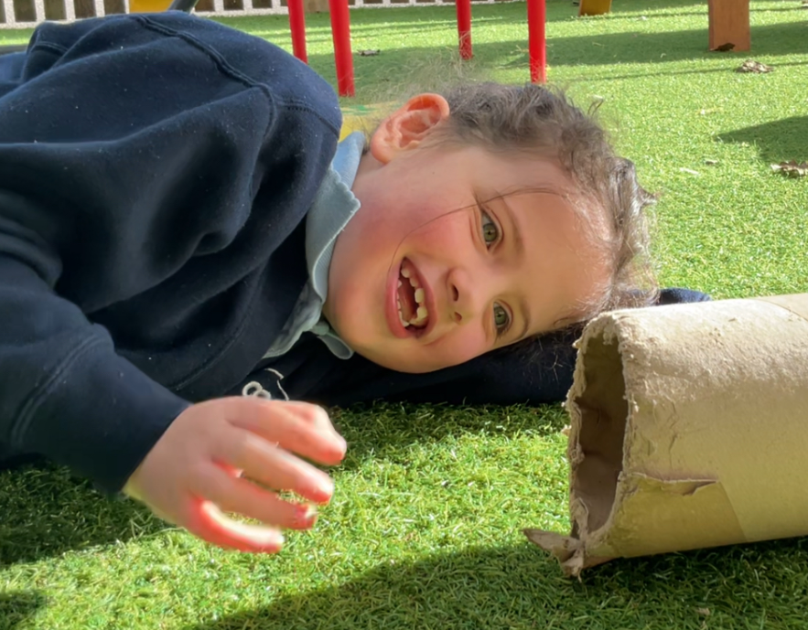
12. How are your resources allocated and matched to my child’s needs?
13. How is the decision made about what type and how much support my child will receive?
FAQ’s
Resources and money are used strategically to support all children including those with additional needs. Resources are allocated according to need and following the advice of other support agencies. All spending and resources are evaluated to ensure a positive impact and that they are cost effective.
A decision will be made about your child’s SEND support depending on their learning support needs or disability and how that affects their development alongside that of their peers or their own previous progress/attainment.
Under the Equality Act 2010, schools are required to make reasonable adjustments for children with a disability.
Co-op Academy Woodslee divides their SEND children into four main categories:
Cognition and Learning
Sensory and Physical
Social, Mental and Emotional Health
Communication and Interaction.
CONTINUED…

Slide 34
13. How is the decision made about what type and how much support my child will receive? (Continued)
FAQ’s
Class teachers, SENDCo and senior leadership team members should make regular assessments of progress for all children.
They will identify children making less than expected progress given their age and individual circumstances. Your child’s progress will be judged by the class teacher or school senior leadership team against this SEND criteria:
Significantly slower than that of their peers starting from the same baseline
Fail to match or better their previous rate of progress
Failing to close the attainment gap between the child and their peers
Widening of the attainment gap between your son/daughter and their peers
Progress might be looked for in other areas other than attainment such as social needs, communication or speech and language.
The first response to such progress will be high quality teaching targeted at the areas of concern. Parents/Carers will be informed by the class teacher at this point.
If progress continues to be less than expected, the class teacher working with the SENDCo, should assess whether your son/daughter has SEND. Parents/carers will be informed at this point by the class teacher or SENDCo, and a learning plan detailing support will be drawn up for parents/carers. If we feel that your child would benefit from some further advice from other support agencies to develop their progress, they will be contacted. Again parents/carers will be informed.
Parents/carers views and knowledge on how to support their child are always valued and are an important part in creating personalised provision that will work for y
our child.
CONTINUED…

Slide 35
13. How is the decision made about what type and how much support my child will receive? (Continued)
14. Who can I contact for further information?
FAQ’s
When additional support is given, the provision is seen as being successful when:
Progress increases and becomes more in line with that of their peers starting from the same baseline
Child’s previous rate of progress improves
The attainment gap between the child and their peers narrows
The attainment gap between your son/daughter and their peers stays stable.
Your first point of contact if you wish to discuss something about your child at Co-op Academy Woodslee would usually be the class teacher.
If you are worried about your child, please come to speak to us at school. An appointment can always be made at the office and often a member of staff may be able to address your worry straight away.
If you are considering whether your child should join us at Co-op Academy Woodslee, you should speak to Ms Bergman, our Executive headteacher and SEND specialist.

Slide 36
15. Can staff get extra help from experts outside if they need to?
(Advice and training on medical conditions).
16. How will information about the child be circulated to all members of staff and who will be responsible for that?
FAQ’s
We use many outside agencies to give us advice on how to support our children depending on their type of SEND. Additional training will be sought depending on a child’s needs and as required.
You may be asked to give permission for school to refer your child to a specialist professional, for example, an Educational Psychologist.
The professional will work alongside school staff, your child and often yourself in order to identify your child’s needs and make appropriate recommendations.
Information about your child will be circulated to members of staff who need to know and they are trusted to be discreet with it and respect any confidential matter.
Pupil Passports will usually be circulated by the class teacher, whilst IHCPs, Costed Provision Maps and EHCPs will usually be circulated by the SENDCo.

Slide 37
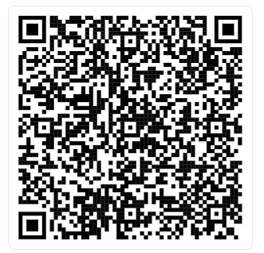
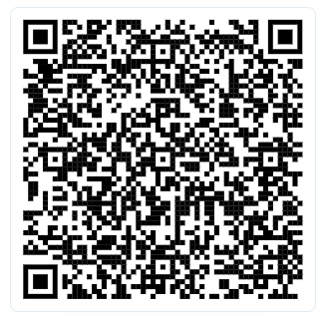
Thank you for looking at our school information report and any frequently asked questions. If you need further information please contact our school by coming in, phoning or emailing: woodslee@coopacademies.co.uk
If you have any questions or feedback please get in touch with our SEND team via the QR code below!
If you would like to book a tour of our connect provisions or mainstream please scan the QR code below!

